Slide 2
Question
One

Slide 3
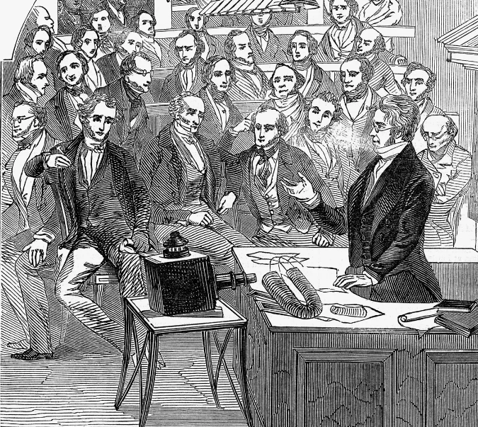
Who was
the first electrician?
Name the great
experimenter who in 1831, discovered that when a permanent magnet is moved inside a copper wire coil, electrical current
flows in the wire?

Slide 4
Question
Two

Slide 5
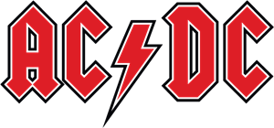
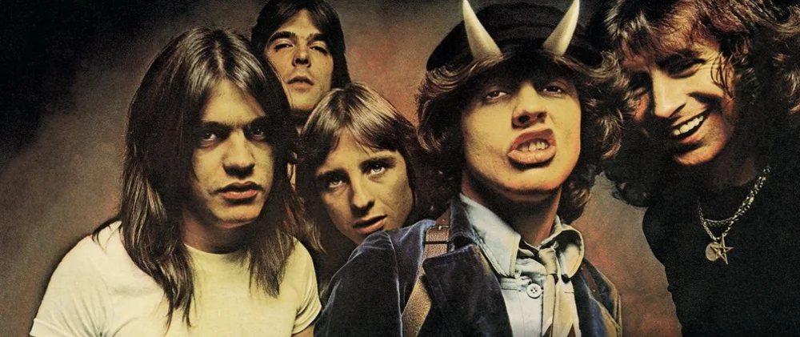
What do the anagrams
AC and DC
mean to an electrician?

Slide 6
Question
Three

Slide 7
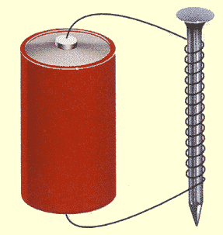
What do we
call any material's tendency to maintain magnetism, even in the absence of a magnetizing
field?

Slide 8
Question
Four

Slide 9
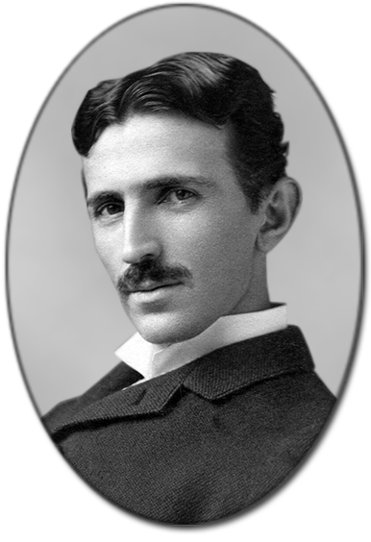
Name the Serbian-American engineer, futurist, and inventor who worked for Edison but quit and partnered with George Westinghouse to champion a nationwide alternating current electricity
supply system.

Slide 10
Question
Five

Slide 11
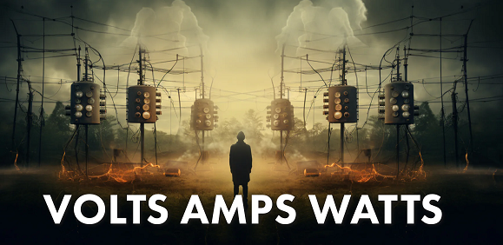
Amps
Watts
Volts
What is the relationship between Amps, Watts and Volts? Please complete the equation,
Amps = ? ? ?

Slide 12
Question
Six

Slide 13
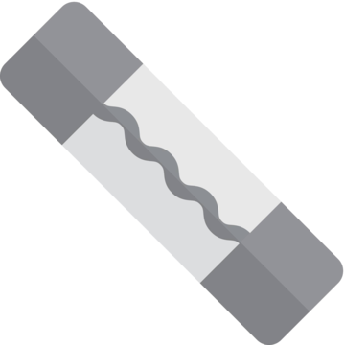
What do we
call the 'sacrificial' device which provides protection from overcharging an electrical circuit. This is usually comprised of a metal wire or strip that will melt if too much current flows through it, thereby stopping the current.

Slide 14
Question
Seven

Slide 15
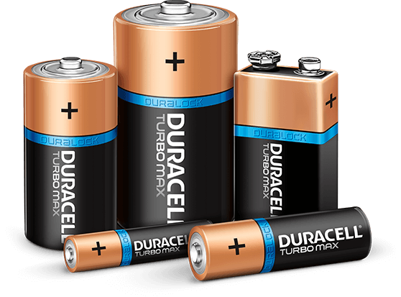
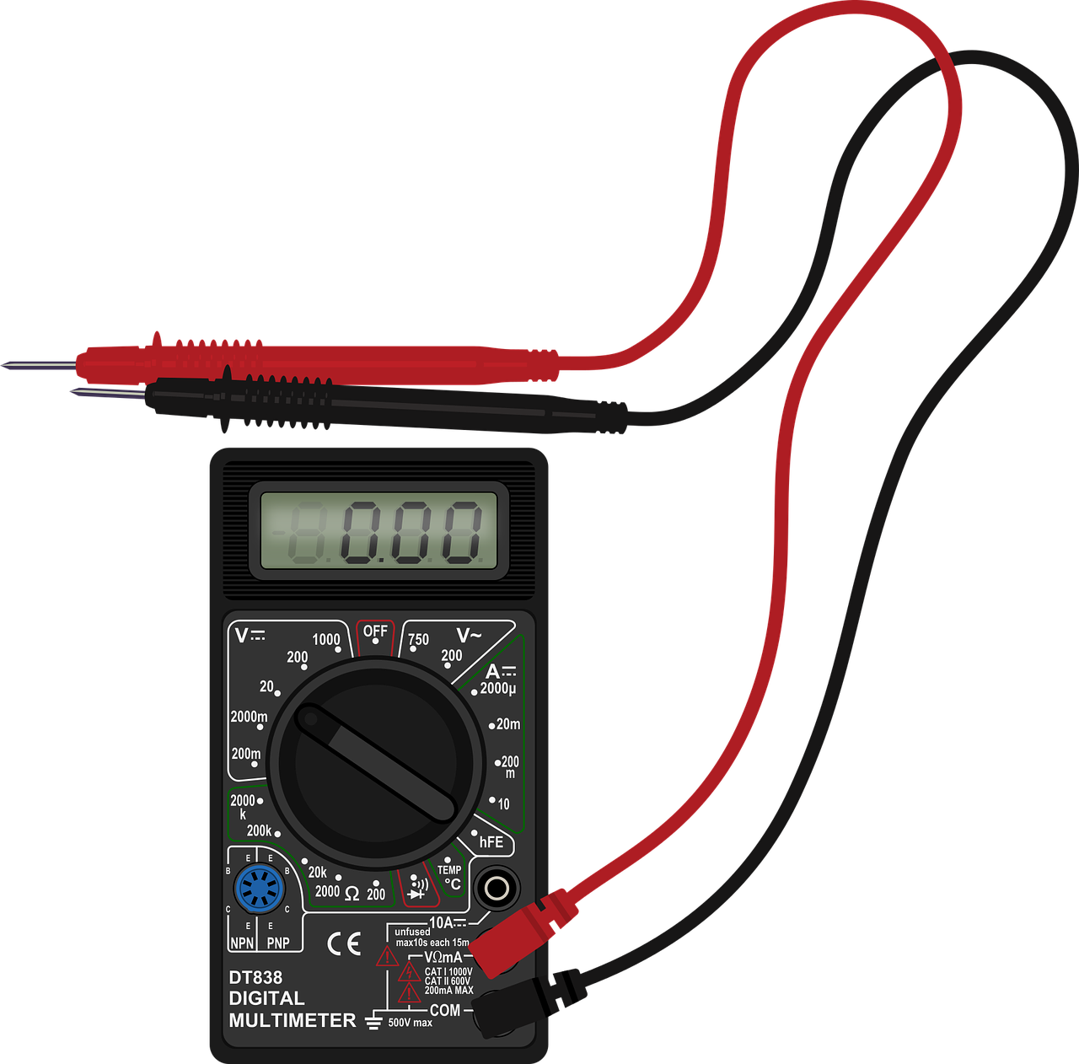
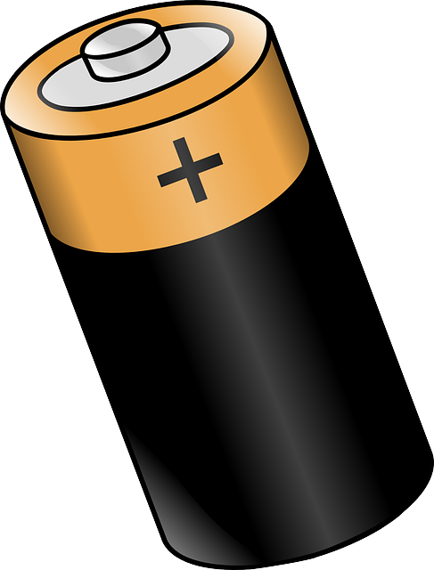
What is
the voltage of a Duracell D - size battery?
D

Slide 16
Question
Eight

Slide 17
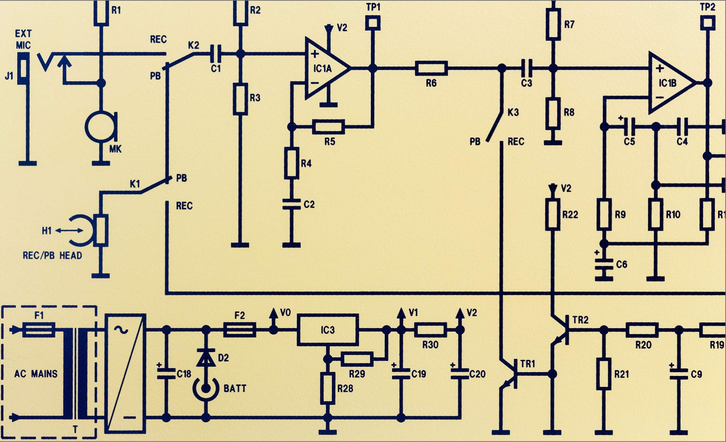
What do
we call the component
used to control the opening and closing of an electric circuit?

Slide 18
Question
Nine

Slide 19
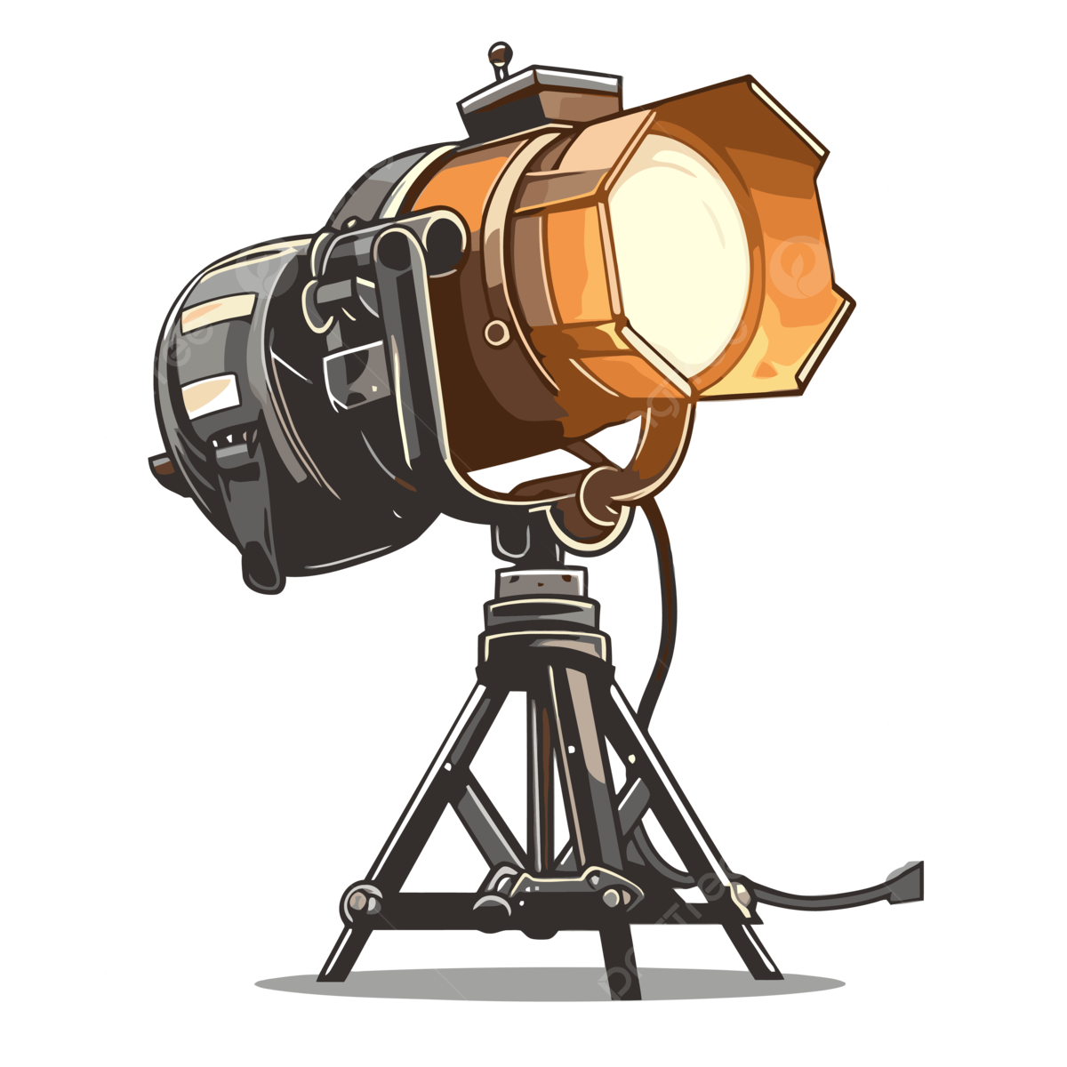
1200 Watt
stage light,
plugged into a 120 volt electrical service will draw how many amps of power?

Slide 20
Question
Ten

Slide 21
What do we call a circuit component which acts as a one-way corridor for current? It allows power to easily flow in one direction, but restricts current from flowing in the opposite direction. On printed circuit diagrams it's usually represented by a triangle ‘pointing’ at a perpendicular line.

Slide 22
Question
Eleven

Slide 23
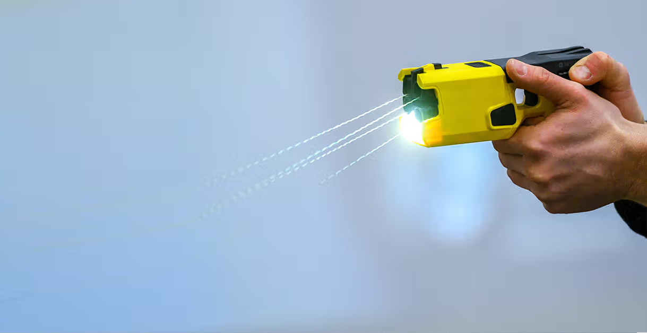
Name the device
which fires two small darts with thin wires, up to a distance of twelve feet? The darts penetrate clothing and, once they make contact with the target, the wires deliver an electric shock, which disrupts the target's nervous system, resulting in temporary incapacitation.

Slide 24
Question
Twelve

Slide 25
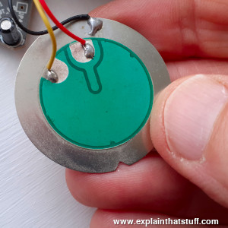
What is inside
a piezoelectric energy harvester which yields electricity when mechanically stressed?

Slide 26
Question
Thirteen

Slide 27
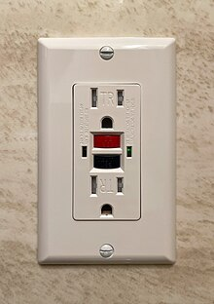
What do we
call the fast-acting circuit breaker designed to shut off electric power in the event of a ‘short’ within as little as 1 / 40 of
a second?

Slide 28
Question
Fourteen

Slide 29
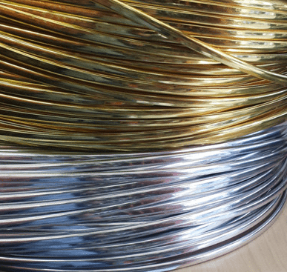
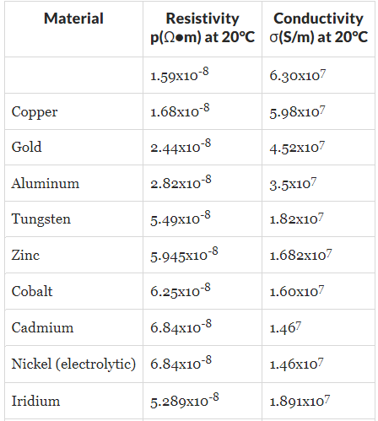
What is the world’s most electrically conductive metal?
?

Slide 30
Question
Fifteen

Slide 31
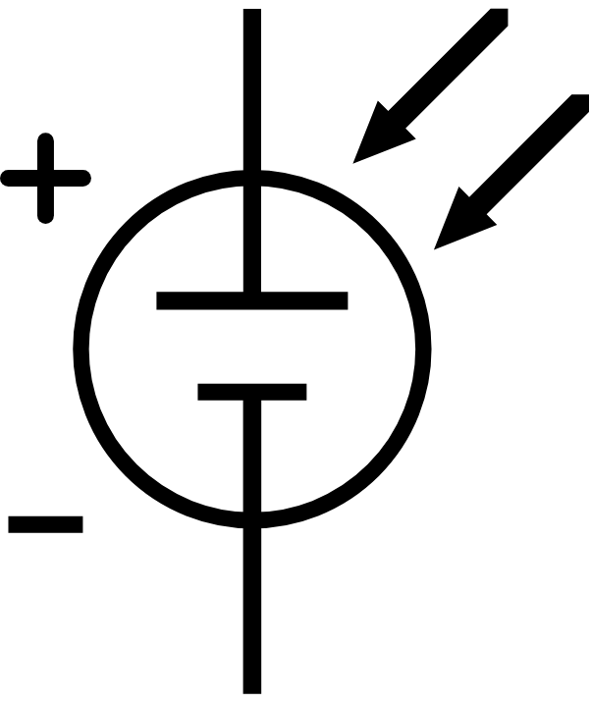
What
manner of energy is collected in a photovoltaic cell?

Slide 32
Question
Sixteen

Slide 33
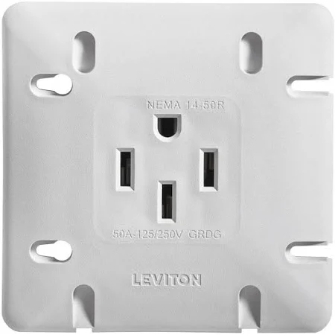
For how many amps is this four-prong AC outlet, commonly found in a modern kitchen, rated?

Slide 34
Question
Seventeen

Slide 35
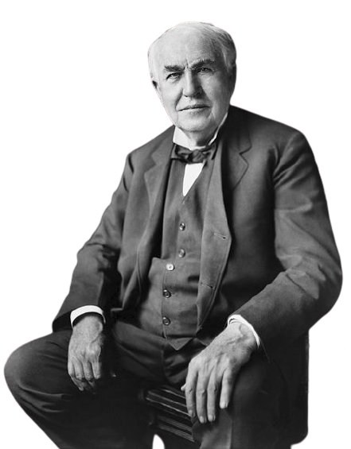
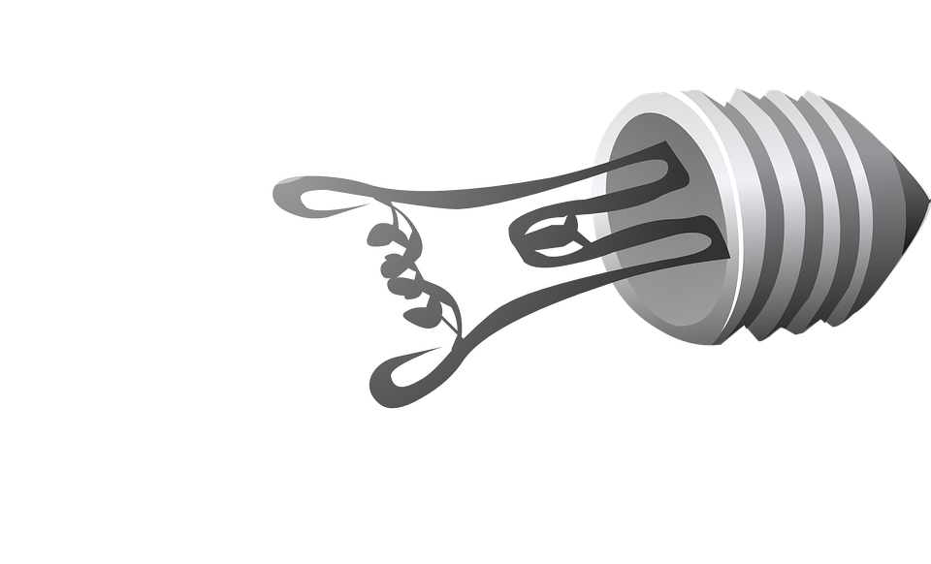
Which substance was electrified in a vacuum to make light in Thomas Edison’s first incandescent
light bulb ?

Slide 36
Question
Eighteen

Slide 37
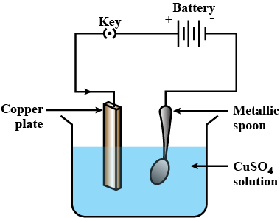
The metal
spoon to be electroplated (coated with a thin layer of copper) is placed at the _________ of an electrolytic cell.

Slide 38
Question
Nineteen

Slide 39
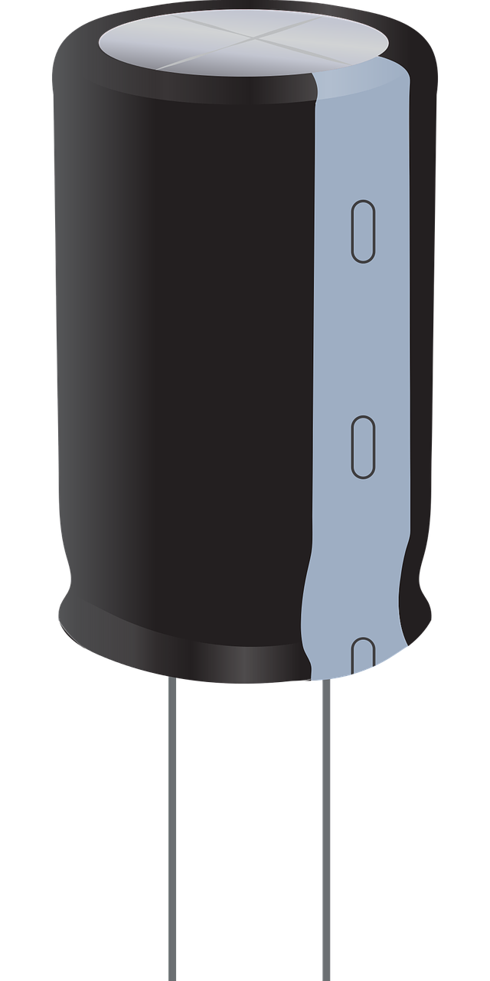
What do we
call the electrical component used to prevent sensitive electronics from power surges?

Slide 40
Question
Twenty

Slide 41
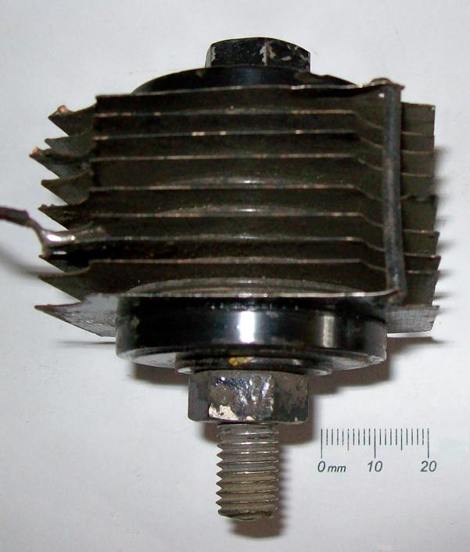
Name electrical
device, patented in 1938 and used extensively in Westinghouse radios to convert alternating current (AC) into direct current (DC) by allowing power to flow through wafer thin semiconductor materials which were either copper oxide, germanium or
selenium.

Slide 42
Thanks
for
Playing

Slide 44
Questions & Answers

Slide 45
Question
One

Slide 46
Who was
the first electrician?
Name the great
experimenter who discovered in 1831 that when a permanent magnet is moved inside a copper wire coil, electrical current
flows in the wire?

Slide 47
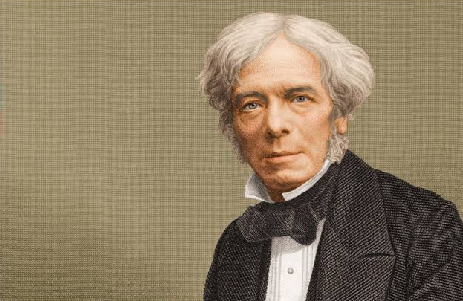
Michael
Faraday FRS
1791 – 1867 was an English scientist and pioneer of electromagnetism. He discovered the principles of electromagnetic induction, diamagnetism and electrolysis. Faraday received little formal education yet he's one of the most influential scientists in
history.

Slide 48
Question
Two

Slide 49
What do the anagrams
AC and DC
mean to an electrician?

Slide 50
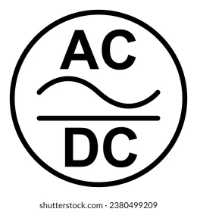
AC is the shorthand for Alternating Current, while DC stands for Direct
Current.

Slide 51
Question
Three

Slide 52
What do we
call any material's tendency to maintain magnetism, even in the absence of a magnetizing field?

Slide 53
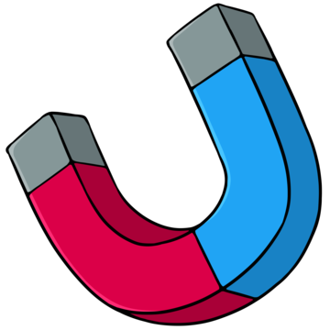
Retentivity.
The ability of any material to retain its magnetism is called Retentivity.

Slide 54
Question
Four

Slide 55
Name the Serbian-American engineer, futurist, and inventor who worked for Edison but quit and partnered with George Westinghouse to champion a nationwide alternating current electricity
supply system.

Slide 56
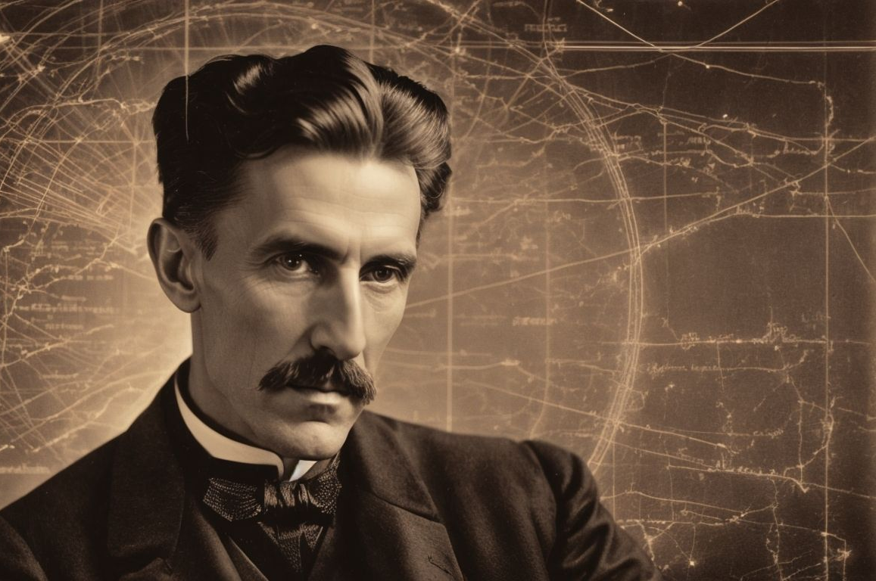
Nikola Tesla was a Serbian American engineer, futurist, and inventor. He is known for his contributions to the design of the modern alternating current (AC).

Slide 57
Question
Five

Slide 58
Amps
Watts
Volts
What is the relationship between Amps, Watts and Volts? Please complete the equation,
Amps = ? ? ?

Slide 59
Amps
=
Watts / Volts
Examples:
4160 Watts / 208 Volts = 20 Amps.
3600 Watts / 240 Volts = 15 Amps.

Slide 60
Question
Six

Slide 61
What do we
call the 'sacrificial' device which provides protection from overcharging an electrical circuit. This is usually comprised of a metal wire or strip that will melt if too much current flows through it, thereby stopping the current.

Slide 62
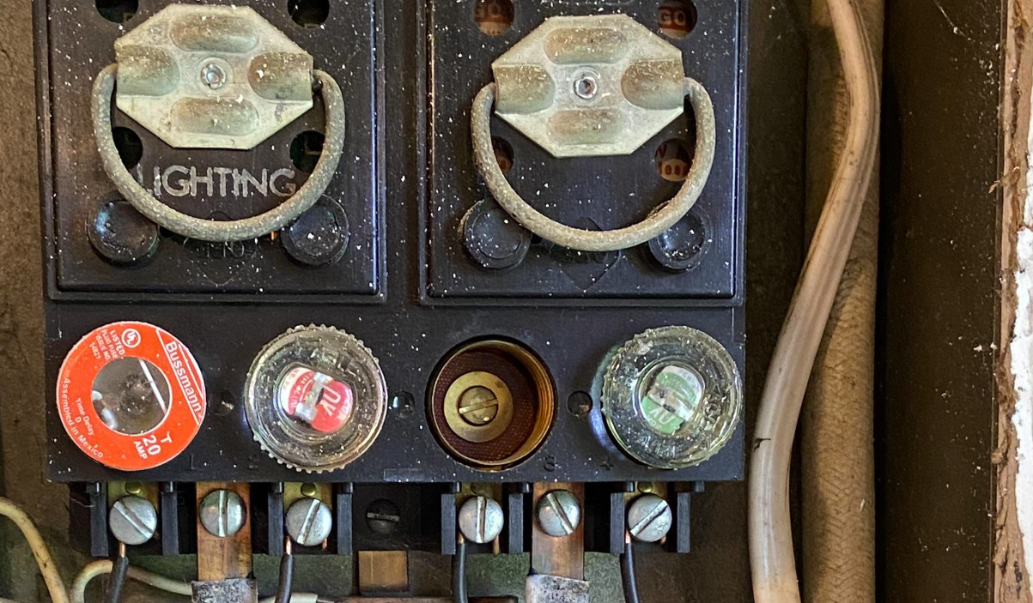
While they are not so common today, fuses were once used in place of breakers. A wide variety of wire or foil fusible elements were in use to protect telegraph cables and lighting fixture as early as 1864. A fuse design was patented by Thomas Edison in 1890 as part of his electric distribution system.

Slide 63
Question
Seven

Slide 64
What is
the voltage of a Duracell size - D battery?
D

Slide 65
1.5 Volts
Most common household batteries deliver 1.5 volts. AA, AAA, C, & D cells are 1.5 volts, and many household and handheld devices are designed to use that voltage or multiples of that voltage. The first zinc-carbon dry cells naturally produced 1.5 volts
of energy, and it has
remained the standard
ever since.

Slide 66
Question
Eight

Slide 67
What do
we call the component
used to control the opening and closing of an electric circuit?

Slide 68
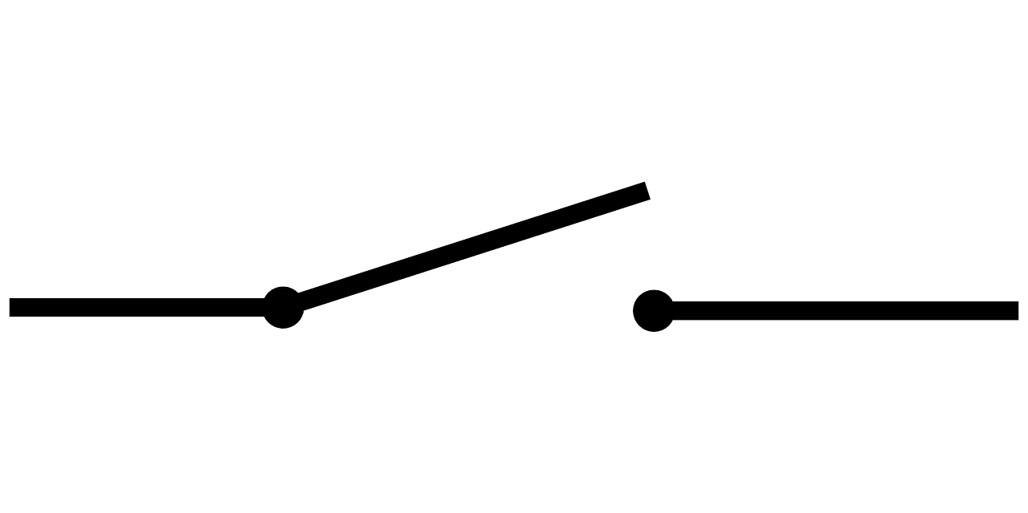
Switch
An electric switch is the component that opens or closes an electric circuit. Opening the switch (breaking the circuit) means turning
something off.

Slide 69
Question
Nine

Slide 70
1200 Watt
stage light,
plugged into a 120 volt electrical service will draw how many amps of power?

Slide 71
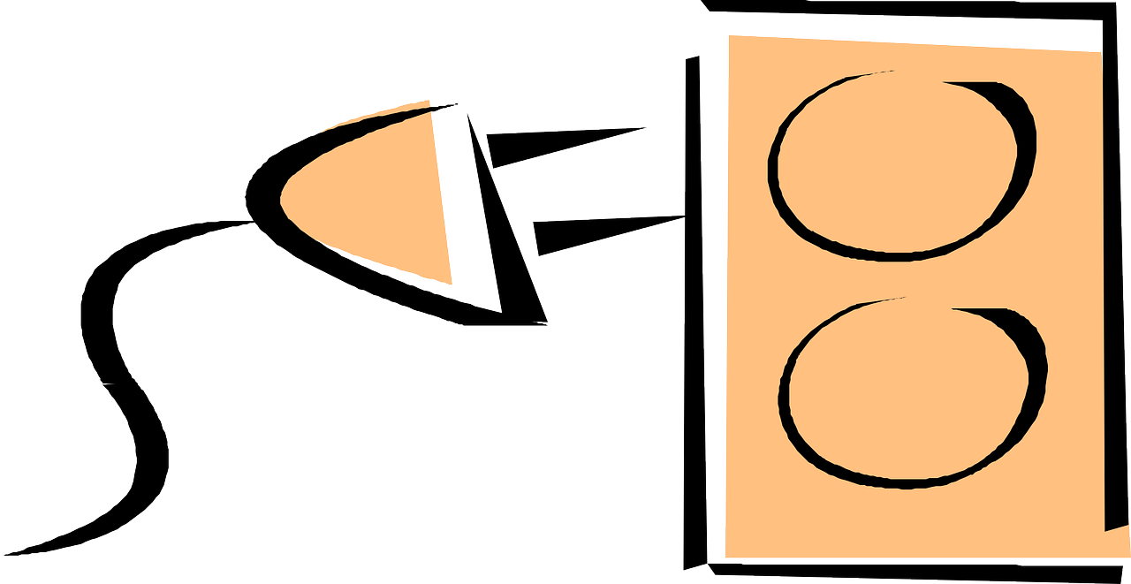
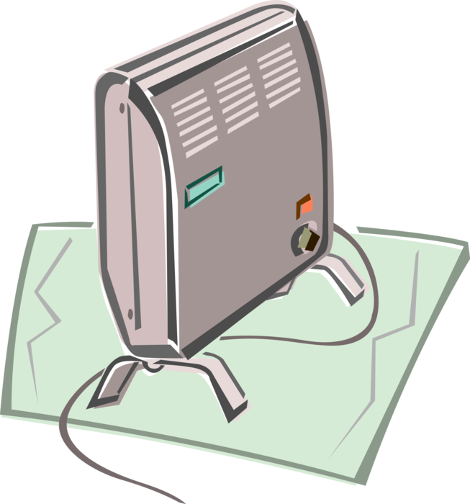
Amperes (A)
=
Watts (W) / Volts (V)
Hence, 1200 watts requires approximately
10 amperes when the circuit operates
at 120 volts.

Slide 72
Question
Ten

Slide 73
What do we call a circuit component which acts as a one-way corridor for current? It allows power to easily flow in one direction, but restricts current from flowing in the opposite direction. On printed circuit diagrams it's usually represented by a triangle ‘pointing’ at a perpendicular line.

Slide 74
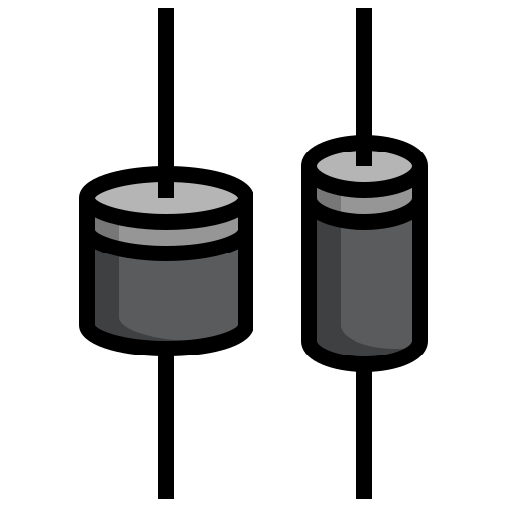
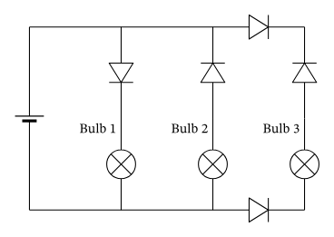
A diode
is a semiconductor which acts as a one-way passage for current. It allows current to flow easily in one direction, but severely restricts current from flowing in the opposite
direction.

Slide 75
Question
Eleven

Slide 76
Name the device
which fires two small darts with thin wires, up to a distance of twelve feet? The darts penetrate clothing and, once they make contact with the target, the wires deliver an electric shock, which disrupts the target's nervous system, resulting in temporary incapacitation.

Slide 77
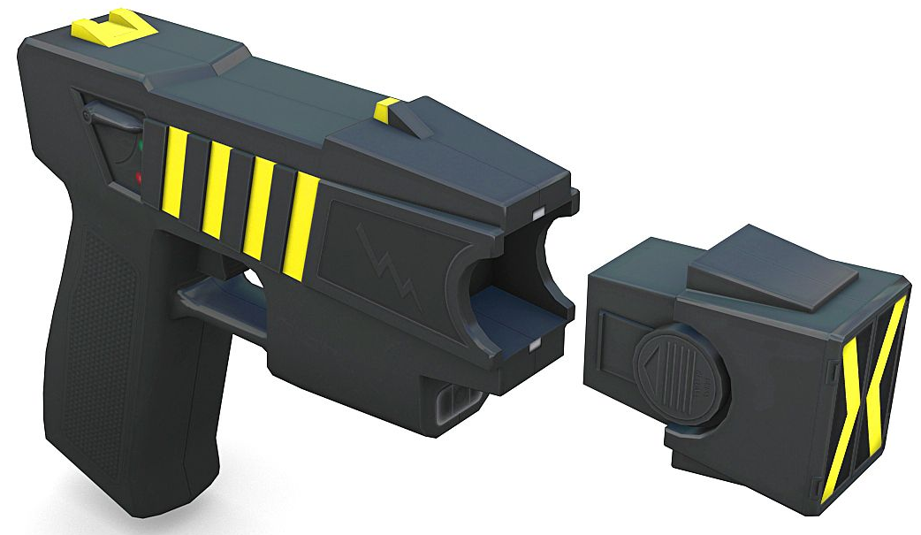
TASER
is a conducted energy device (CED) used to incapacitate people, allowing them to be approached and handled in a less-lethal manner.

Slide 78
Question
Twelve

Slide 79
What’s inside
a piezoelectric energy harvester which yields electricity when mechanically stressed?

Slide 80
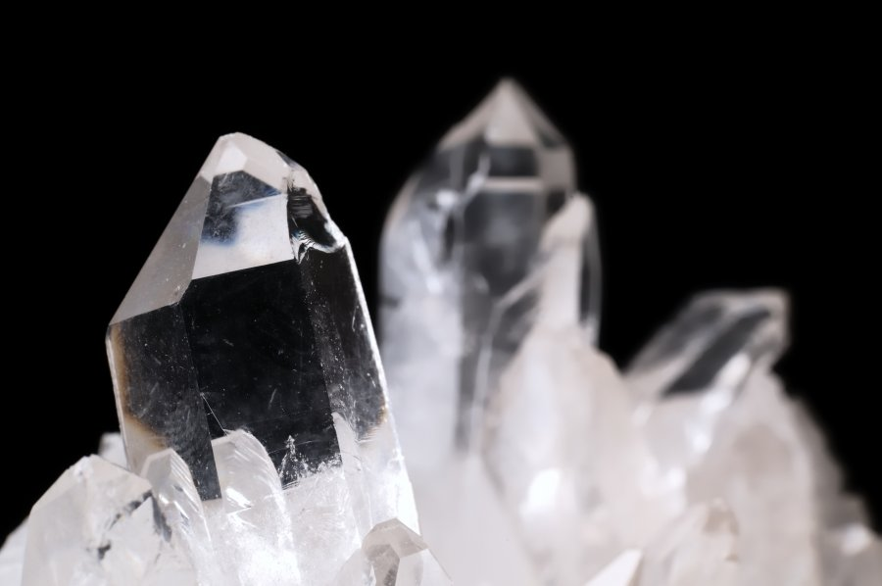
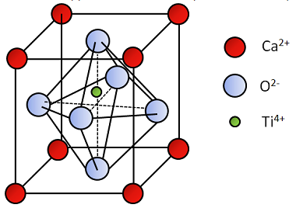
Crystals
Some natural crystals, such as quartz, lithium sulfate, tourmaline, and Rochelle salt possess piezoelectric qualities and will yield a small charge when mechanically stressed.

Slide 81
Question
Thirteen

Slide 82
What do we
call the fast-acting circuit breaker designed to shut off electric power in the event of a ‘short’ within as little as 1 / 40 of
a second?

Slide 83
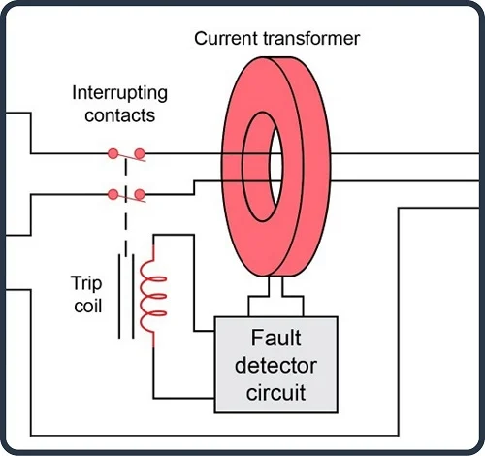
A ground fault circuit interrupter, called a GFCI or GFI, is an inexpensive electrical device which can either be installed in your electrical system or built into a power cord to protect you from severe electrical
shocks.

Slide 84
Question
Fourteen

Slide 85
What is the world’s most electrically conductive metal?
?

Slide 86
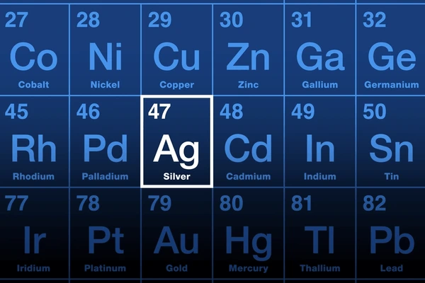
Silver
is the best conductor because its electrons are easier to move than those of any other element, making it more suitable for the conduction of electricity and heat than any other element.

Slide 87
Question
Fifteen

Slide 88
What
manner of energy is collected in a photovoltaic cell?

Slide 89
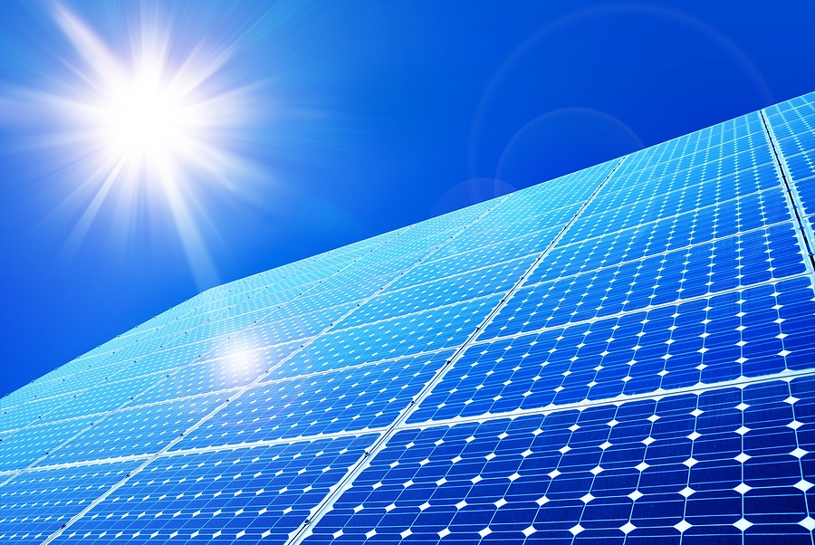
Solar
Photovoltaic (PV) cells are commonly called solar cells. They are devices which convert sunlight directly
into electricity.

Slide 90
Question
Sixteen

Slide 91
How many
amps is this four-prong AC outlet, commonly found in a modern kitchen, rated?

Slide 92
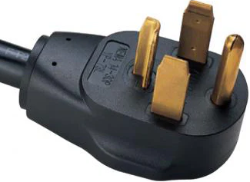
This plug
has four prongs and
is commonly used for larger appliances which require more electrical power, for stoves and air conditioning units. The two hot wires in a 50 amp RV plug each carry 110-120 volts of electricity, and when combined, they provide the necessary
220-240 volts.

Slide 93
Question
Seventeen

Slide 94
Which substance was electrified in a vacuum to make light in Thomas Edison’s first incandescent
light bulb ?

Slide 95
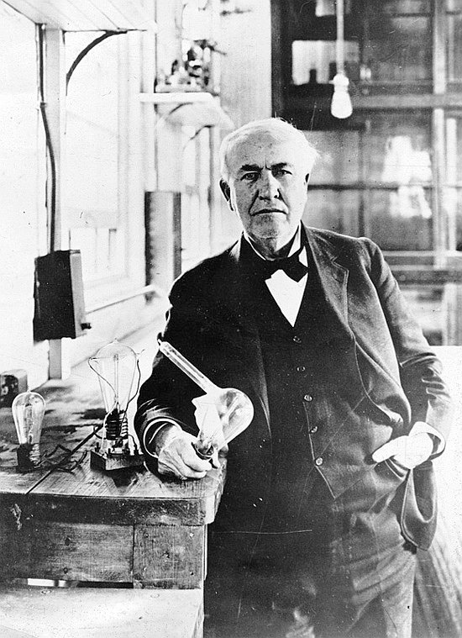
Carbon, carbonized bamboo
The first light bulbs did not have Tungsten filaments but were made with carbonized bamboo. These early bulbs would only last a few days or weeks, which was annoying, but that was still longer than
a candle and the bulbs were much brighter.

Slide 96
Question
Eighteen

Slide 97
The metal
spoon to be electroplated (coated with a thin layer of metal) is placed at the _________ of an electrolytic cell.

Slide 98
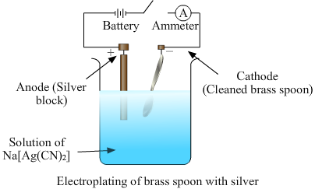
Cathode.
The spoon to be electroplated is placed at the cathode of an electrolytic cell.

Slide 99
Question
Nineteen

Slide 100
What do we
call the electrical component used block direct current while allowing alternating current?

Slide 101
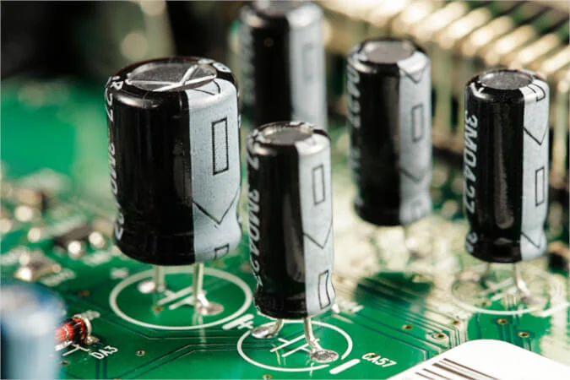
Capacitors
are used in electronic circuits to block direct current while allowing alternating current to pass. In analog filter networks, they smooth the output of power supplies.

Slide 102
Question
Twenty

Slide 103
Which electrical
device, patented in 1938 and used extensively in Westinghouse radios converts alternating current (AC) into direct current (DC) by allowing power to flow through wafer thin semiconductor materials which are either copper oxide, germanium or
selenium.

Slide 104
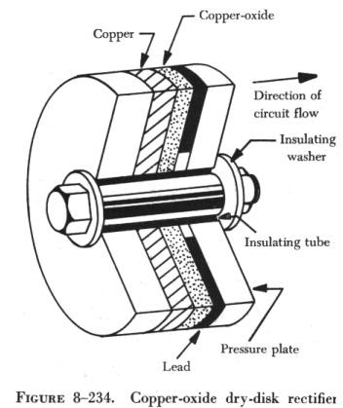
A metal rectifier
is an early type of rectifier in which the semiconductor is copper oxide, germanium or selenium. They were used in power applications to convert alternating current to direct current in devices such as radios and battery chargers.

Slide 105
Thanks
for
Playing

